Slide 1
Team
Nicholas Sciannameo – Zero Liu Meng Xie – JJ Hou
Sherry Ma – Albert Tian
Advisers
John Dessler – Ruth Comley

Slide 2
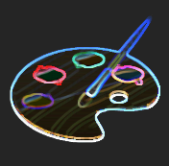
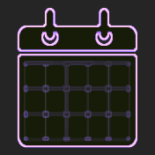
Half Presentation
Scope
Design
Demo
Playtests
Schedule
Challenges

Slide 3
What is Factomo?

Slide 4
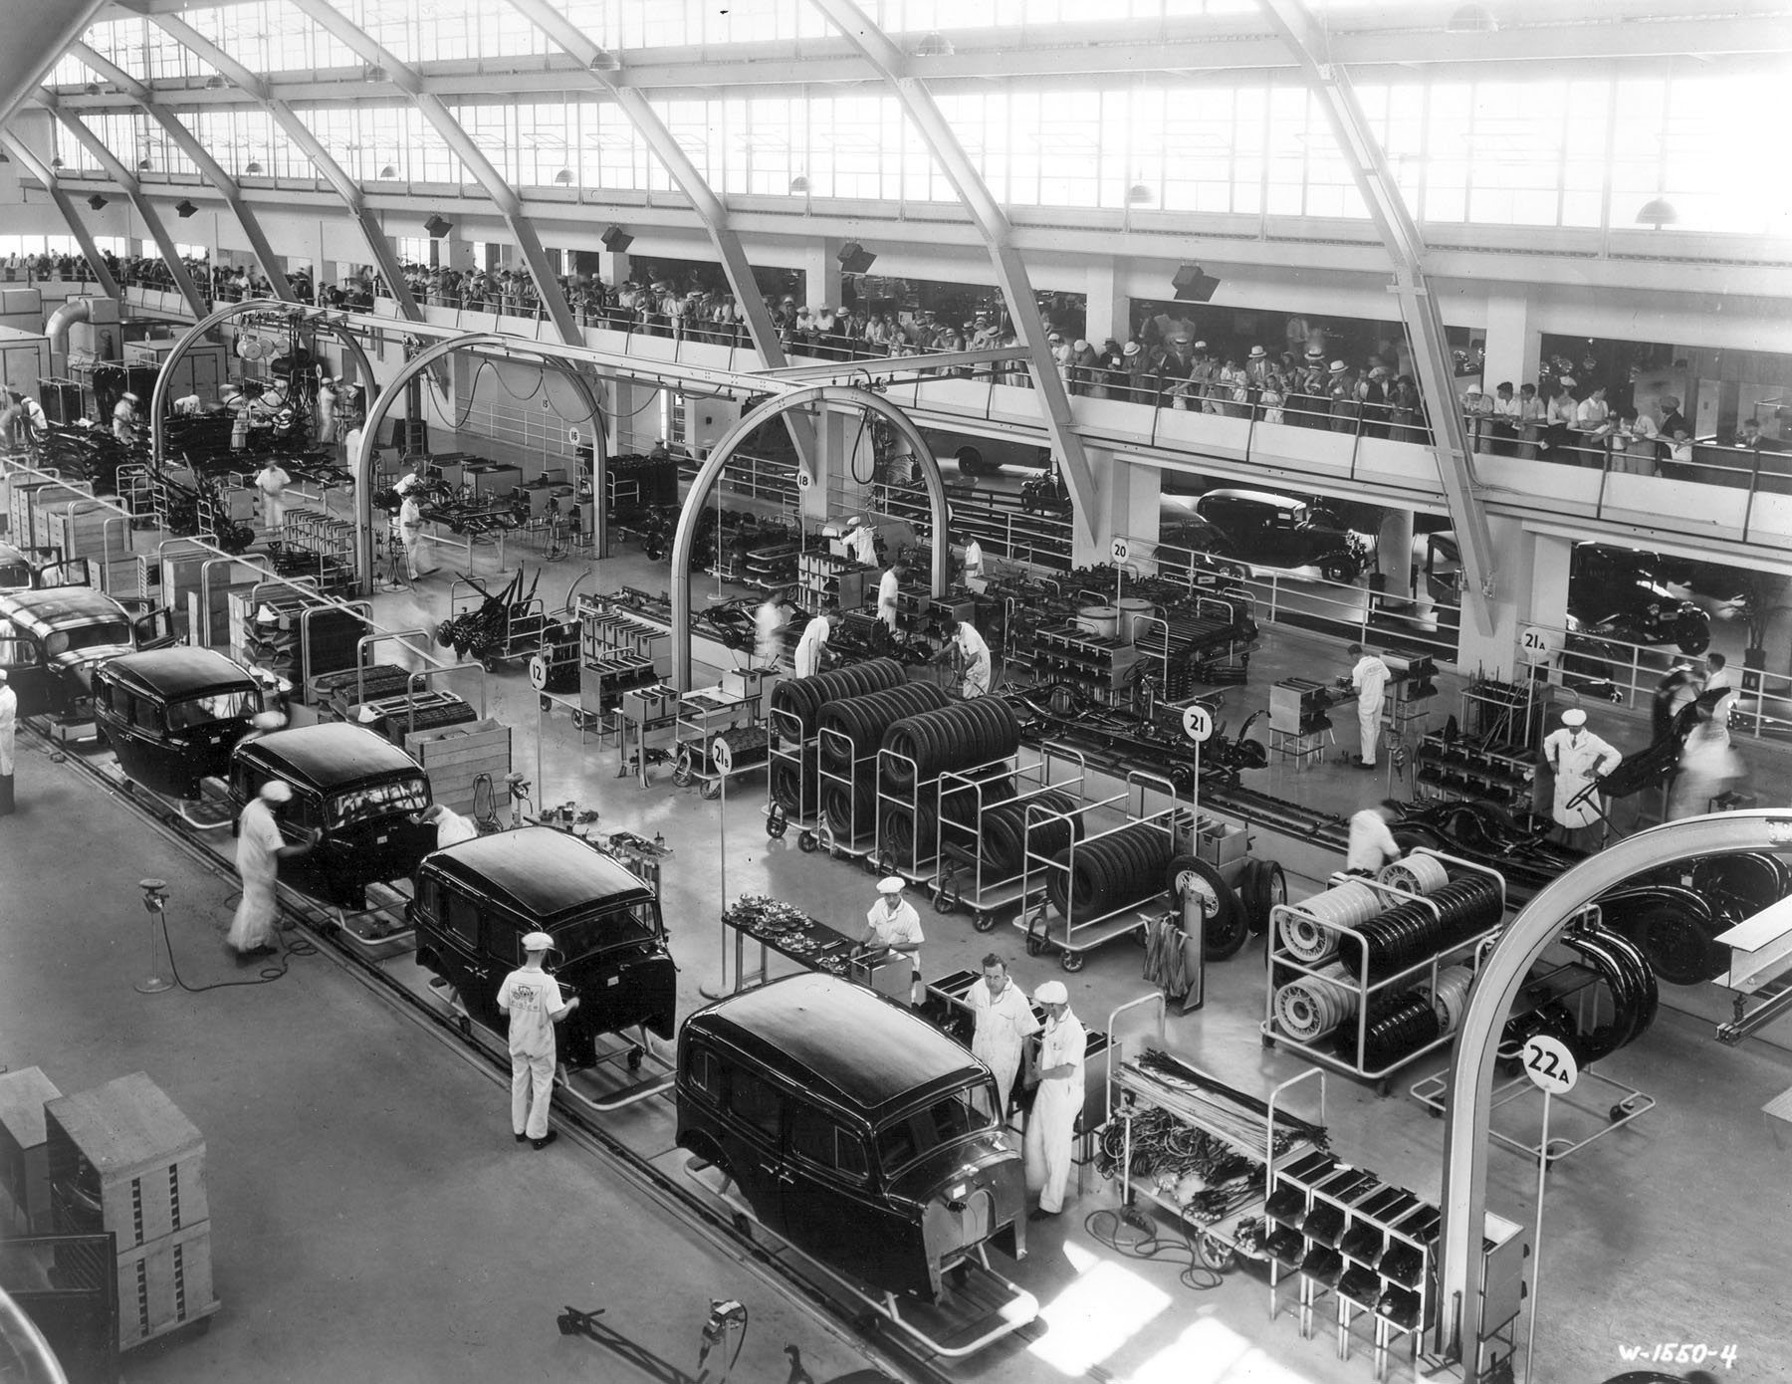
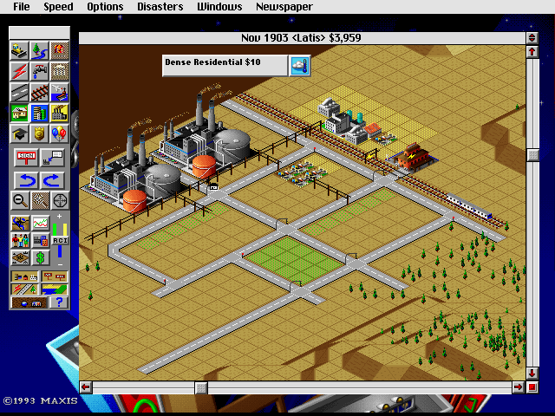
The Big Picture
Notes:
Title
To create a simulation serious game of the automobile assembly line
Objective
Enhance the communication between the GM engineers and the non-designers (College students, operators)
Let non-designer involves in the layout design work and let their innovative design inspire the idea of the GM engineers
Make those who are interested in GM or automobile assembly line experience the GM working environment
Target
College students operators
GM engineers

Slide 5
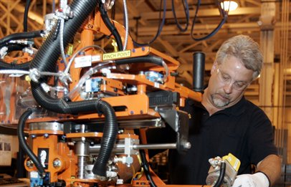
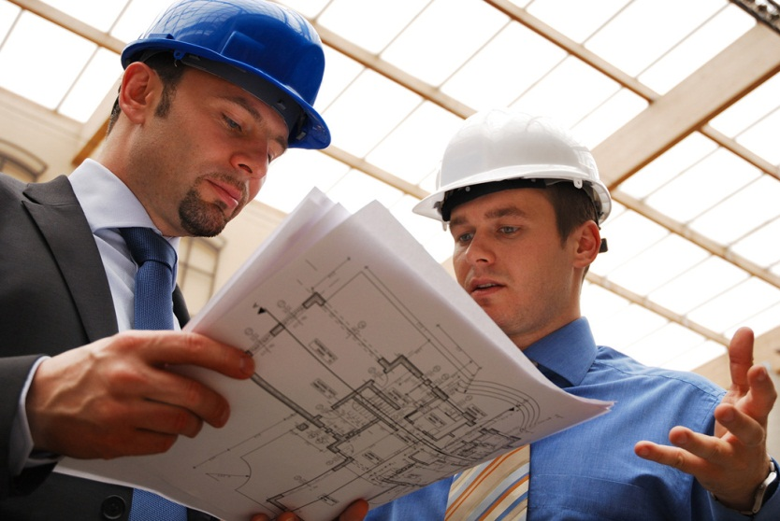
Target Demographic
GM Assembly line operators
GM engineers
General Public/
Students
Notes:
Title
To create a simulation serious game of the automobile assembly line
Objective
Enhance the communication between the GM engineers and the non-designers (College students, operators)
Let non-designer involves in the layout design work and let their innovative design inspire the idea of the GM engineers
Make those who are interested in GM or automobile assembly line experience the GM working environment
Target
College students operators
GM engineers

Slide 6
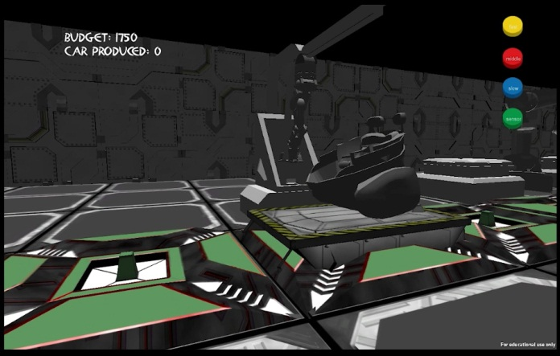
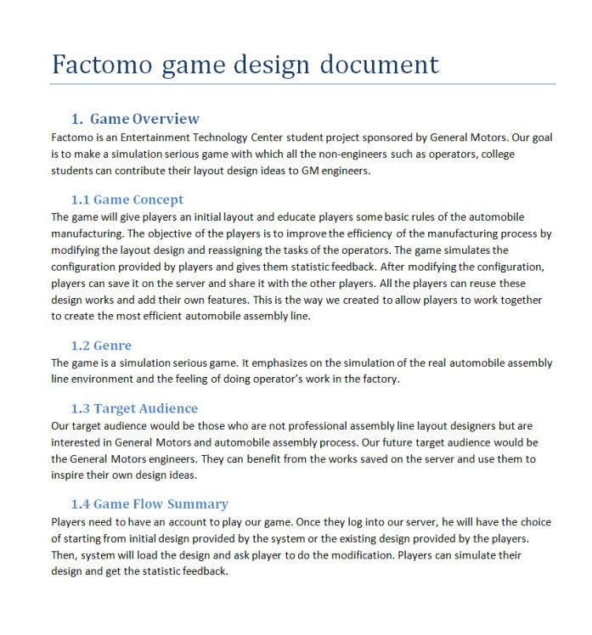
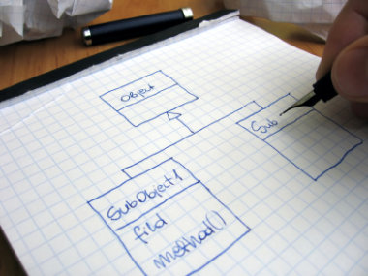
Deliverables
Notes:
Unity game
Login/Register website
Game design document
Software Development document

Slide 7
Metrics For Success
The game can prove the concept
The game is scalable and can be reused by the next team
Notes:
Unity game
Login/Register website
Game design document
Software Development document

Slide 8
Difference from SIGMA
Operation Simulation
Load
Bolt
Snap
Cable
Mini-Game
High-level actions
Notes:
Design
High level actions instead of mini-games
Single player design – Multiple player design
Collaborative design
Players asynchronously submit their works and can reuse the design of the other players

Slide 9
Difference from SIGMA
Collaborative Design
Notes:
Design
High level actions instead of mini-games
Single player design – Multiple player design
Collaborative design
Players asynchronously submit their works and can reuse the design of the other players

Slide 10
Inheritance from SIGMA
Notes:
Machine models
Experience
Clients do not like mini-games
Clients appreciate the realistic working experience and environment

Slide 11
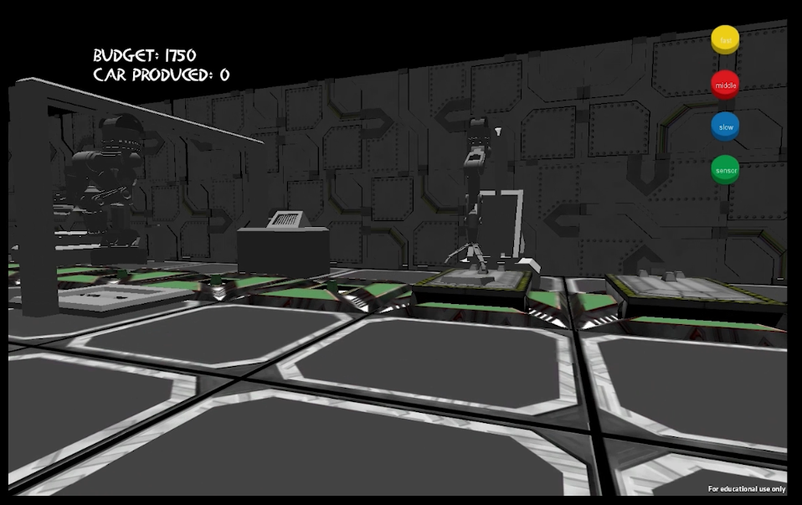
Inheritance from SIGMA
Experience!
Notes:
Machine models
Experience
Clients do not like mini-games
Clients appreciate the realistic working experience and environment

Slide 12
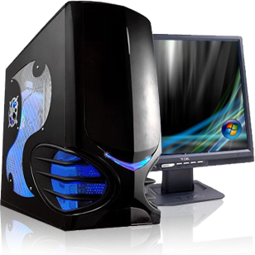
Game Design
Platform: PC
Important features:
Save high scores online
Save configurations online
Notes:
PC
Online (High score, Load others’ layout design)

Slide 13
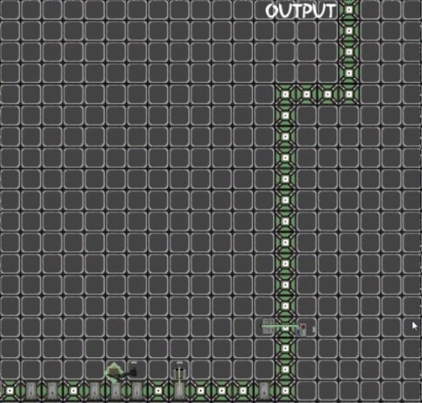
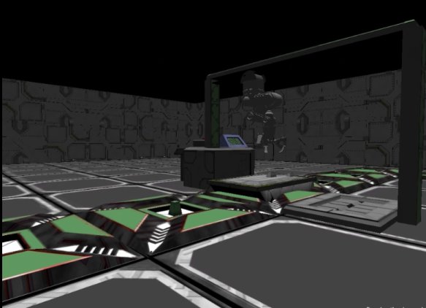
Flow
Create player
Game start
Login
Design
Load design
Save configurations
Simulation
Notes:
PC
Online (High score, Load others’ layout design)

Slide 14
Layout Design
S
L
C
B
L
L
L
B
Notes:
PC
Online (High score, Load others’ layout design)

Slide 15
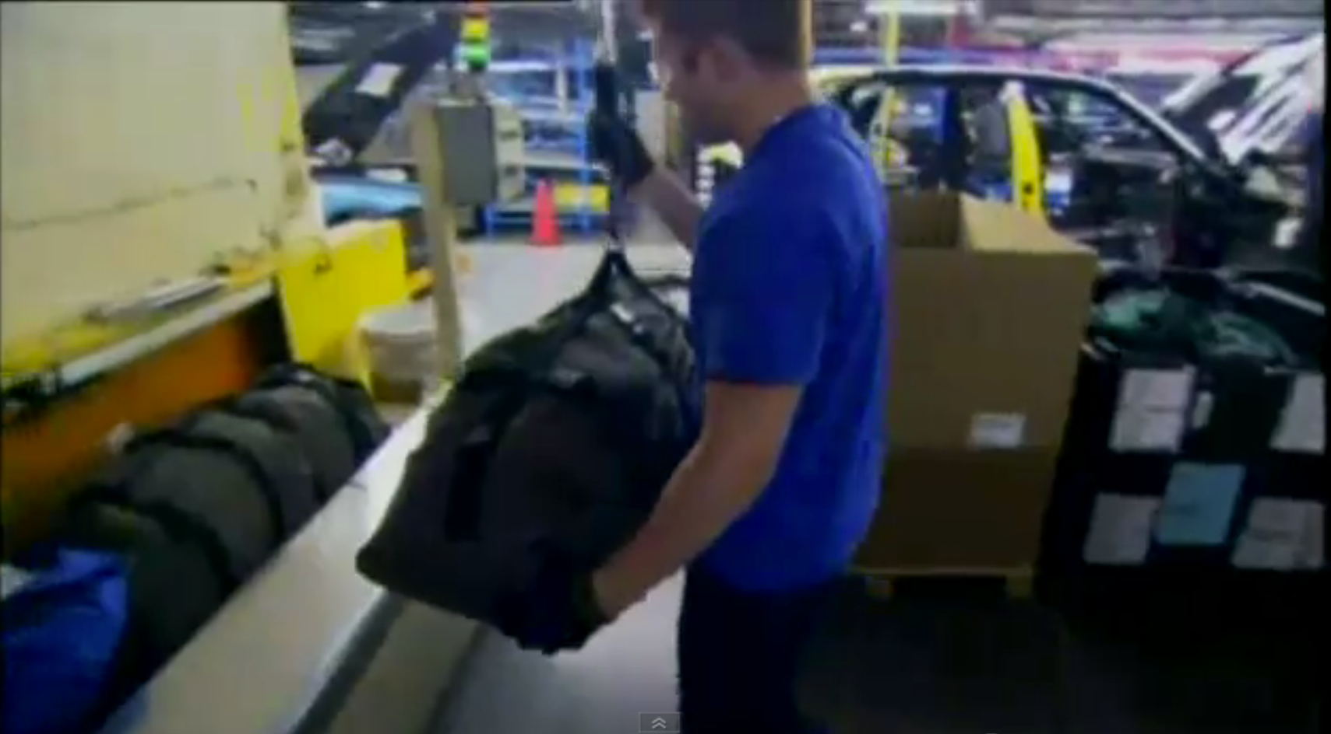
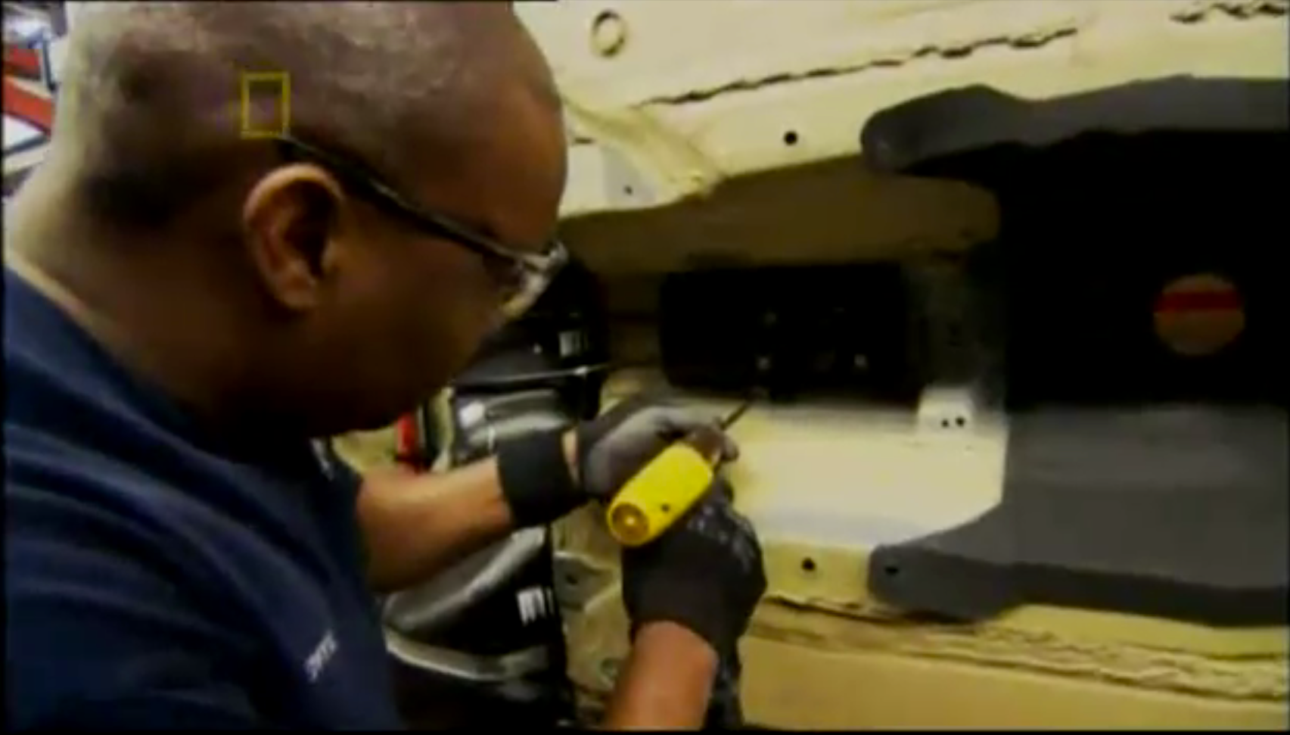
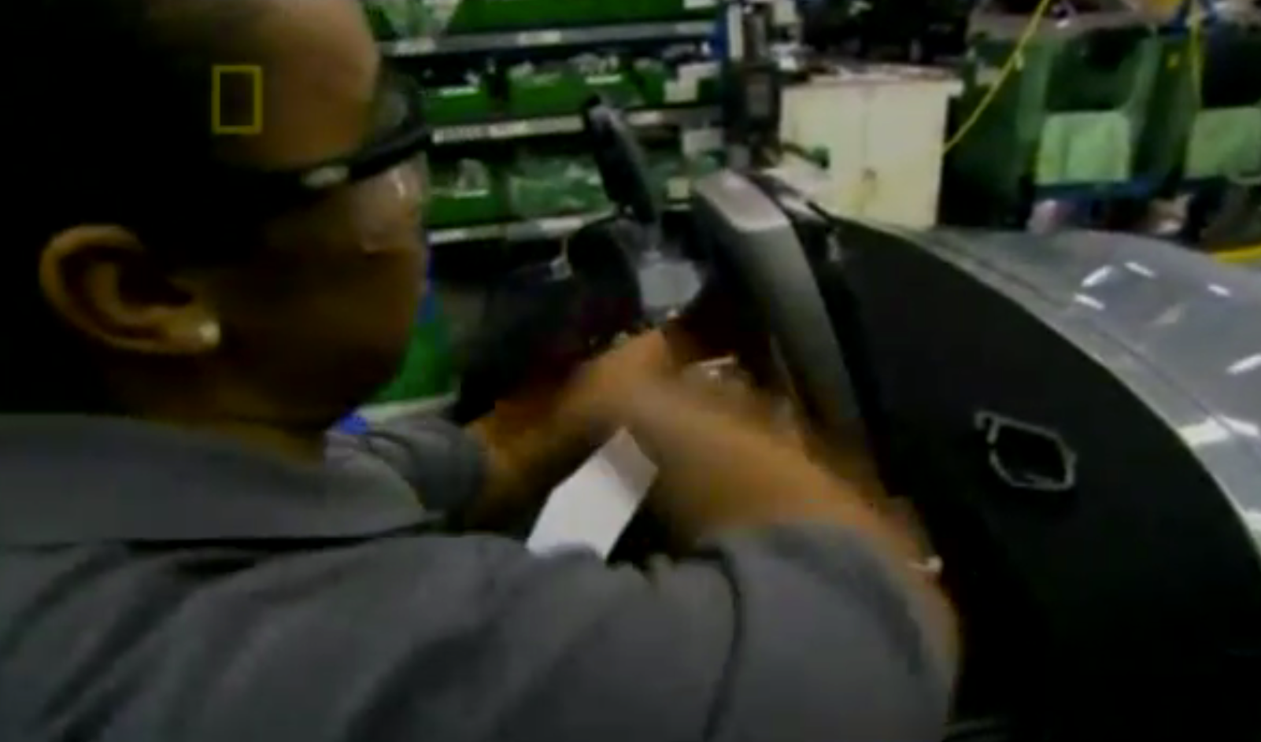
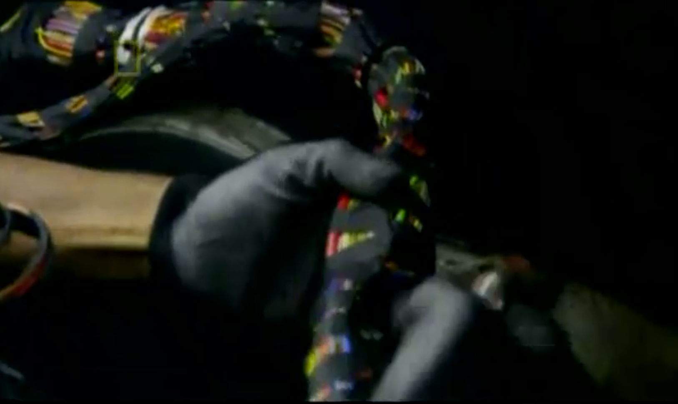
Action Details
L
Load
B
Bolt
S
Snap
C
Connect Cable
Notes:
PC
Online (High score, Load others’ layout design)

Slide 16
Action Details
Right Wheel
Bolt
Left Wheel
Bolt
Battery
Load
Load
Load
Bolt
Cable
Notes:
PC
Online (High score, Load others’ layout design)

Slide 17
Precedence
Chassis
Right Wheel
Heater
AC
Left Wheel
Battery
Console Box
Steering Column
Notes:
PC
Online (High score, Load others’ layout design)

Slide 18
What the player can change
Decrease the length of the sensors
Notes:
PC
Online (High score, Load others’ layout design)

Slide 19
What the player can change
Create alternative path
L
L
L
Notes:
PC
Online (High score, Load others’ layout design)

Slide 20
What the player can change
More features will be added according to the results of playtest and the schedule
Station customization
Operator status
…
Notes:
PC
Online (High score, Load others’ layout design)

Slide 21
Quarters Feedback
Make something simple that works!
Notes:
Make something simple that works
Drop 3rd person view feature
Work through client’s requirements and prioritize more precisely
How to define efficiency
Narrow down the scope

Slide 22
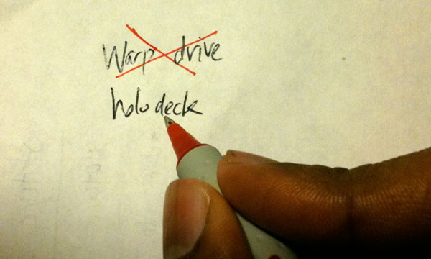
Quarters Feedback
Make something simple that works!
Cut Features
Prioritize Tasks More Precisely
Simplify Ranking System
Simplified
Notes:
Make something simple that works
Cut features
Prioritize tasks
Simplify ranking system
Drop 3rd person view feature
Work through client’s requirements and prioritize more precisely
How to define efficiency
Narrow down the scope

Slide 23
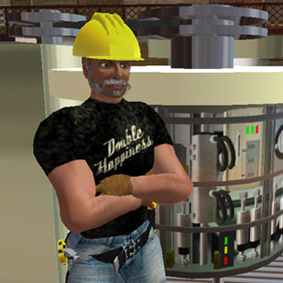
Quarters Feedback
Drop 3rd Person View Feature!
Notes:
Make something simple that works
Drop 3rd person view feature
Work through client’s requirements and prioritize more precisely
How to define efficiency
Narrow down the scope

Slide 24
Quarters Feedback
Drop 3rd person view feature!
Reuse SIGMA assets
Make it of secondary importance
Notes:
Reuse SIGMA’s models
Make it less important

Slide 25
Quarters Feedback
How Is Efficiency Defined?
Notes:
How to define efficiency

Slide 26
Quarters Feedback
How Is Efficiency Defined?
Time
Cost
Throughput
Fixed
Fixed
?
Notes:
2 ways
Fix time and throughput, compare the cost. The less the better
Fix time and cost, compare the throughput. The more the better

Slide 27
Demo
Notes:
Gameplay:
Show them the global working process
Show them how to add or change a machine or a sensor
Show them if we add things in different order, there will be an error
Ranking:
Player register on the website
Game can login
Model:
Car models
Human models
Machine models

Slide 28
Playtest
Previous SIGMA team members
Previous SIGMA play testers
New to this project
ETC students
EA visitors

Slide 29
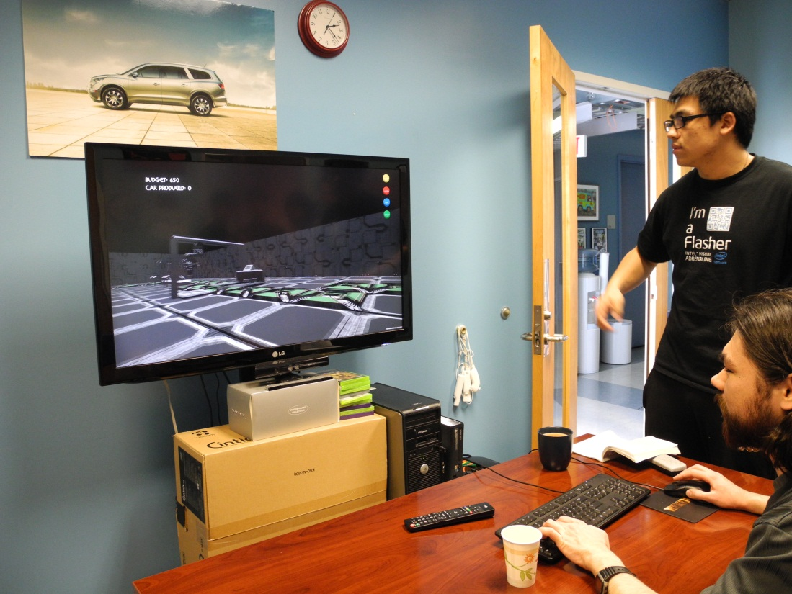
Playtest
Previous SIGMA team members & Previous SIGMA play testers
More advanced

Slide 30
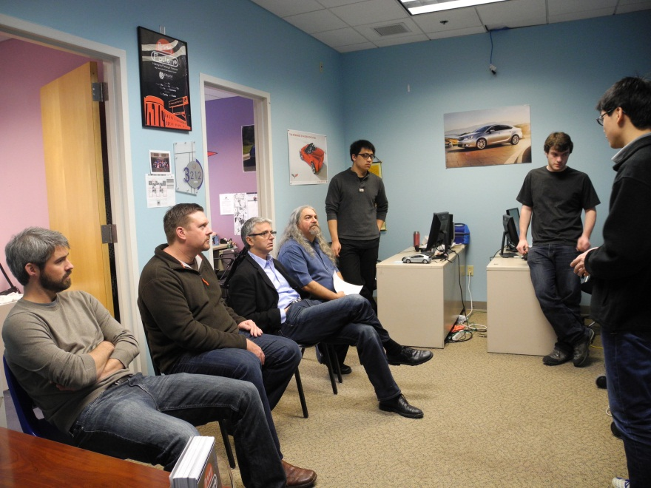
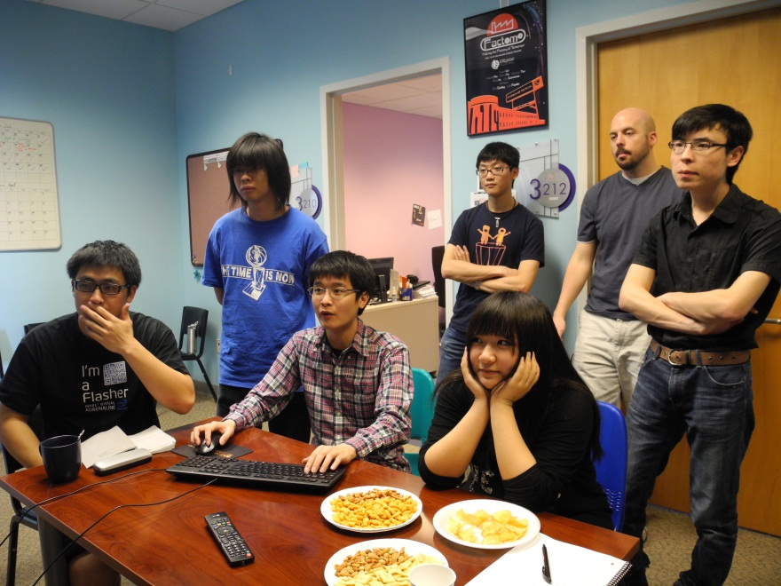
Playtest
New to this project
It works!
Cool models!
Why 3D?
Need clearer UI
Design suggestions

Slide 31
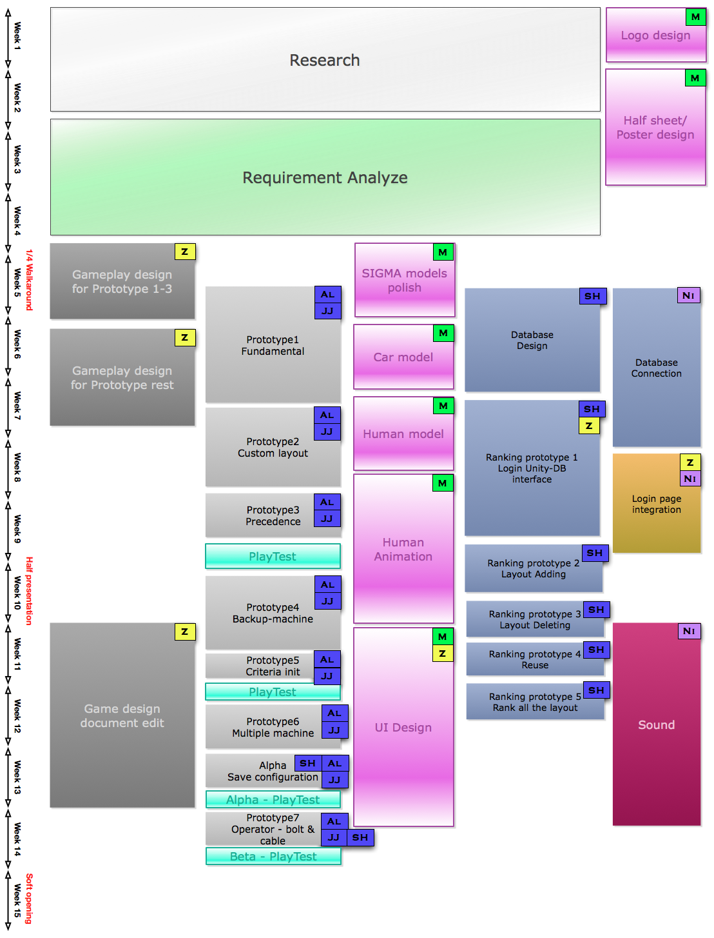

Slide 33
Challenges
Time Management
- project work, elective assignments and sleep
Database Connection with GM
- no technical support from GM
- almost impossible to find a bypass solution
- a solution to playtest the game inside GM is obligatory
Large scale goals
- impossible to fulfill the requirement in one semester
Notes:
Time management (between project work, elective assignment and sleep)
Database connection to GM
Layout design balancing
Cooperation among programmers

Slide 34
Solution
Time Management
- Get used to the schedule and the workload
Database Connection with GM
- Mini VM
Large scale goals
- Cut features
- Make it scalable and reusable
Notes:
Time management (between project work, elective assignment and sleep)
Database connection to GM
Layout design balancing
Cooperation among programmers

Slide 35
Thank You
Robert Tilove Ron Lesperance
Team SIGMA
Evan Brown
Don Marinelli
Drew Davidson
Jesse Schell John J Dessler
Mk Haley Ruth C Comley All of our Playtesters!
Notes:
Time management (between project work, elective assignment and sleep)
Database connection to GM
Layout design balancing
Cooperation among programmers

Slide 36
Questions
Notes:
Time management (between project work, elective assignment and sleep)
Database connection to GM
Layout design balancing
Cooperation among programmers

