Slide 1
Persona
Week Two

Slide 2
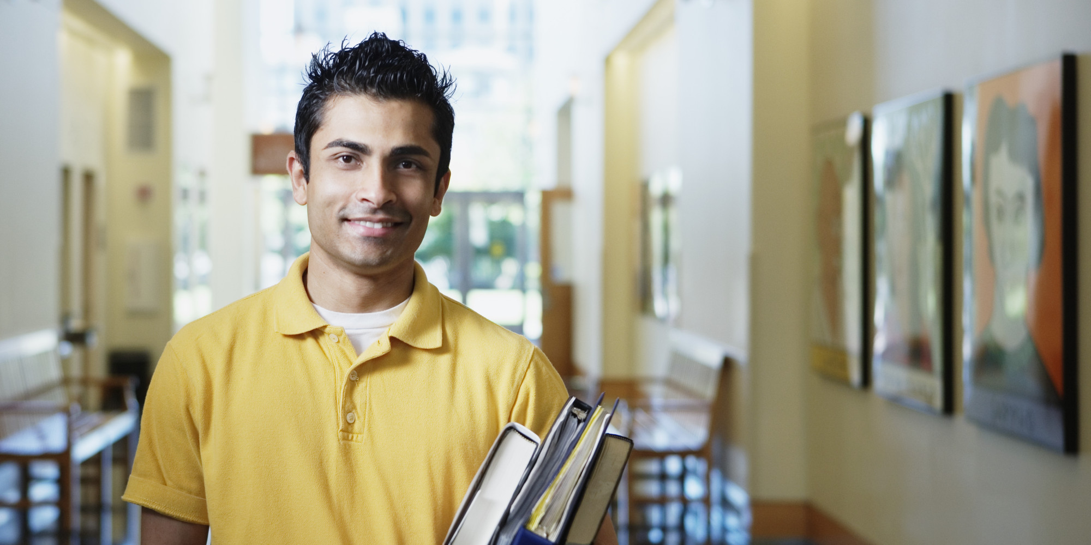
New Coder: Ryan
Ryan came from a humanity background. After college, he worked for two years in a local business. In his first job, he had the opportunity to work with several developers. He wanted to communicate better with his co-workers, so he started to teach himself basic coding with some online materials. Ryan found himself actually interested in coding, and then decided to pursue a higher degree in CS. He got admitted to one of the CS program in CMU. He was excited but also a little bit worried, because he knew little about formal CS education.
Since he taught himself a little bit before coming back to school, he knows how to get answers and helps from online communities. This could be one of his great advantages, but if used in a wrong way, it could also be one of the biggest obstacles for him. Sometimes, he doesn’t know which code he could borrow, and which he couldn’t.
Name: Ryan
Age: 24
Major: Computer Science

Slide 3
Culture learner: Julia
Julia comes to CMU as an international student. She also comes right after undergrad. Struggling with language and culture challenges, Julia finds graduate study a lot more stressful than what she expected. She knows several friends from her undergrad college, and she feels relaxed with these friends.
The biggest challenge for Julia is dealing with attributions and citations. In her home country, borrowing other’s work is completely normal. She thinks there might be a different requirement here in the US, but she has no idea what exactly that is. When she has a question, she would turn to her friends from her country for help. However, her friends are no experts.
Name: Julia
Age: 21
Major: Humanity

Slide 4
Returning Professional: Catherine
Catherine worked in a business company for a couple of years. Her boss wanted her to lead an office in another city, and sponsored her for an MBA degree in CMU.
As a business major student, there are lots of socializing activities. Catherine is super active in those events, because she knows that that is one of the biggest benefit she could get from business school. However, spending lots of time socializing sometimes pushes her to the edge. Catherine feels the pressure that she has to have good grades to return the trust of her boss, but this strong desire sometimes blinds her.
Name: Catherine
Age: 29
Major: Business

Slide 5
Relationship Truster: Dylan
Dylan is a smart and out-going guy. He has so many good buddies, and he loves helping people. He usually never says no to his friends, but when it comes to academic life, he knows that he shouldn’t give his friends any inappropriate help.
First year in grad school, Dylan met this pretty girl in his class and the girl became his girlfriend. Since they are in the same program, they often have same assignments. Dylan usually will help his girlfriend by answering questions and inspiring her when she is stucked. There are also certain moments when the deadline is just too close, and he is too busy with other assignments. He would just give his answers to his girlfriend for reference, and trust her judgement.
Name: Dylan
Age: 23
Major: Computer Science

