Slide 2
2

Slide 3
Chautauqua Interactive
Advisors:
The Team:
Drew Davidson
Brenda Harger
Goutham Dindukurthi
Kyle Dolan
Ben Miller
Francisco Souki
Aaron Vanderbeek
Client Representatives:
Margaret Johnson
Bonnie Nelson Schwartz

Slide 4
The Client
Gated community known for 9 week-long Summer Season featuring Opera, Theater, Dance, Lectures, etc.
Chautauqua International Festival of Arts and Innovation
First occurrence in Sept 2009, during off-season.

Slide 5
Our Audience
Well-heeled intellectuals
Not necessarily familiar with high-tech.
The most tech-based solutions could still ignite very interesting discussions.

Slide 6
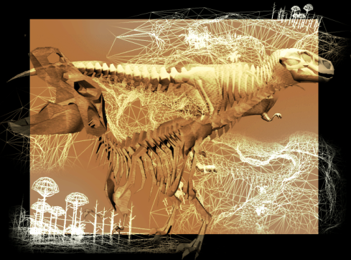
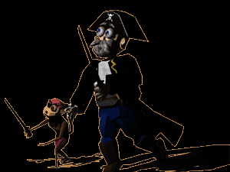
Previous ETC Projects
EROShambo

Slide 7
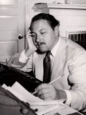
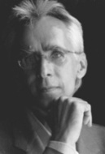
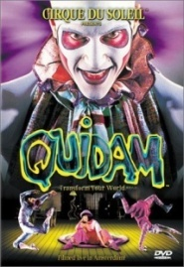
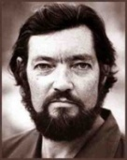
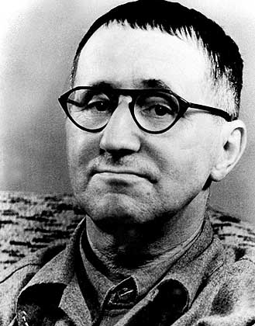
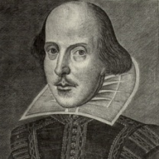
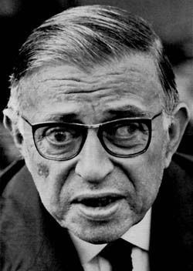
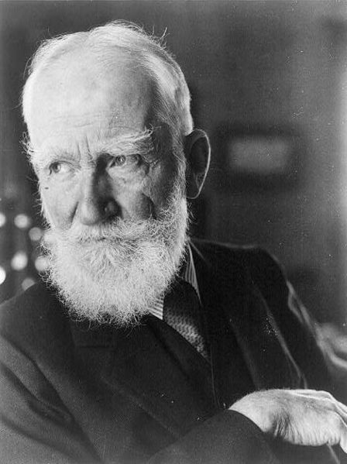
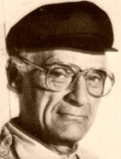
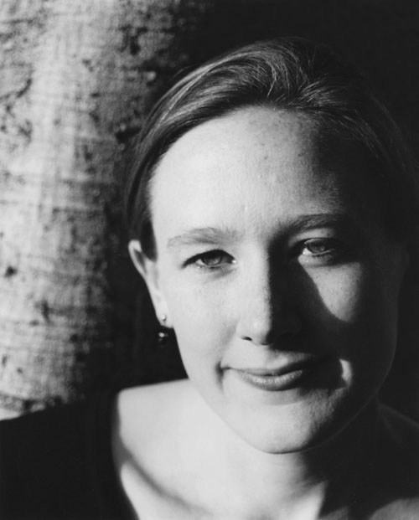
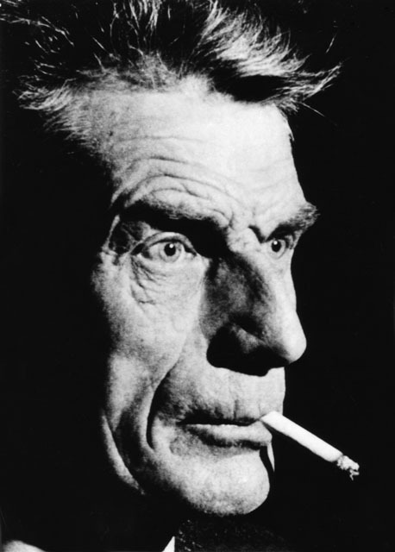
Research
Short Stories
Full Length Plays
1-Act Plays
Film
Performance

Slide 8
Research
Short Stories
Full Length Plays
1-Act Plays
Film
Performance
PERSPECTIVE

Slide 9
Our Goal
To combine technology and theatrical performance art for the purpose of creating a meaningful interactive experience for the audience.
To engender the feeling of agency in the audience, which we believe will significantly enhance the experience created by a theatrical performance on many levels.

Slide 10
Deliverable
End of Semester:
Two live, proof-of-concept Interactive Drama performances.
September:
The Symposium at Chautauqua:
Performances
Discussion / Panel

Slide 11
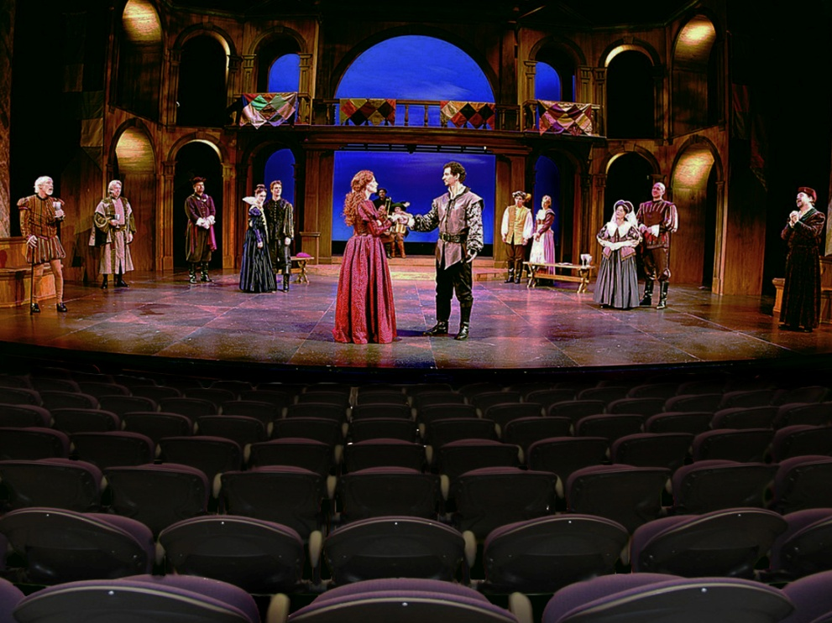
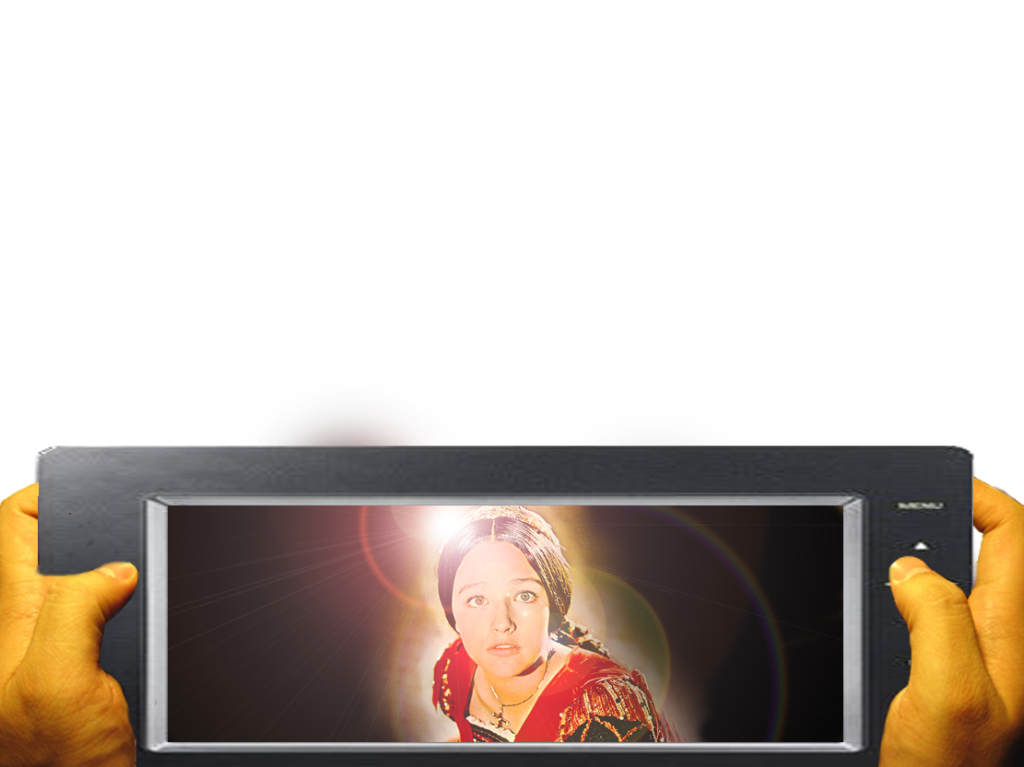
Our 3 Ideas from 1/4
Idea #1: Multiple Perspectives

Slide 12
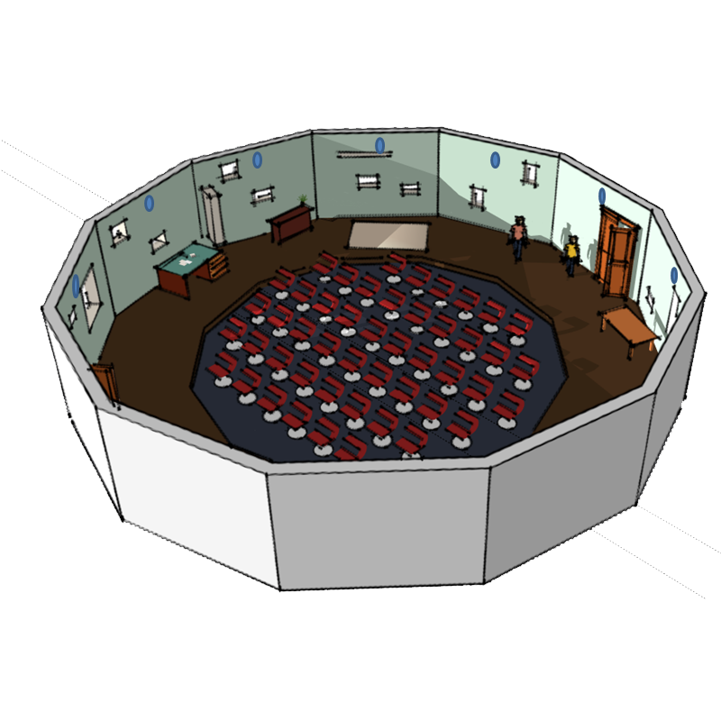
Our 3 Ideas from 1/4
Idea #2: 360° dynamic sound generation

Slide 13
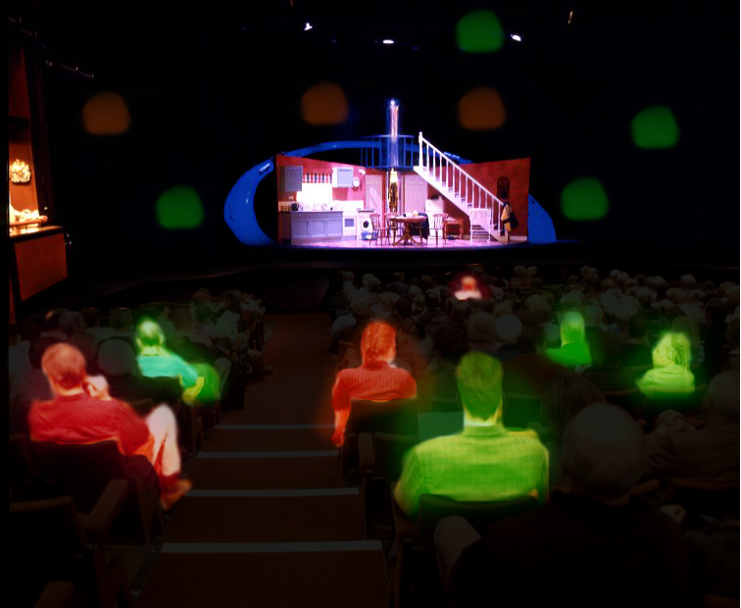
Our 3 Ideas from 1/4
Idea #3: Audience-controlled lights

Slide 14
Feedback from 1/4
Mixed feedback on all 3 ideas we presented
Most importantly:
Do not distract people, integrate the tech.
Create something simple that leaves a lasting impression.
Do not be afraid to move far beyond the realm of traditional theater.

Slide 15
What have we been doing?
Idea #3: Audience-controlled lights

Slide 16
What have we been doing?
Settled on a story

Slide 17
What have we been doing?
Settled on a story
Two Stories!
Rashomon
Hamlet + Rosencrantz and Guildernstern are Dead

Slide 18
What have we been doing?
Focused work on 2 short prototypes
Hardware
Software
Script
Design Docs

Slide 19
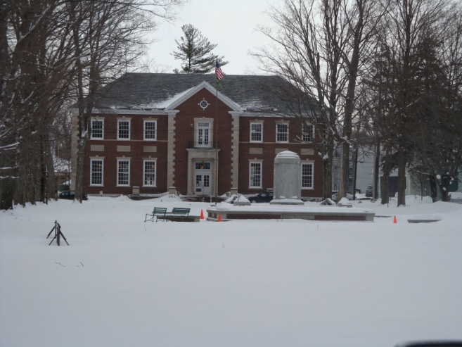
What have we been doing?
Visit to Chautauqua

Slide 20
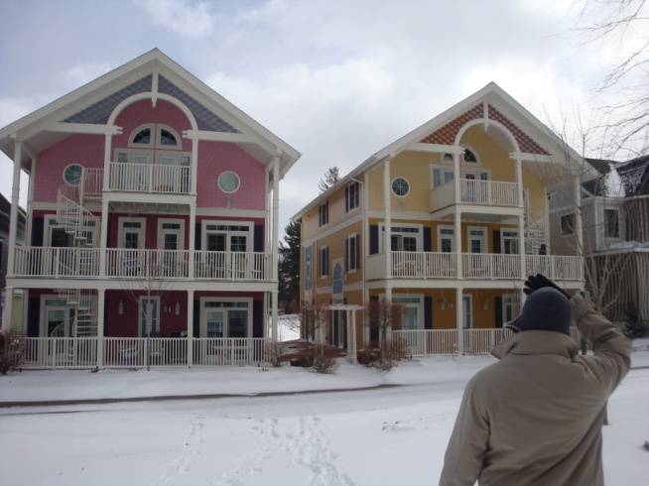
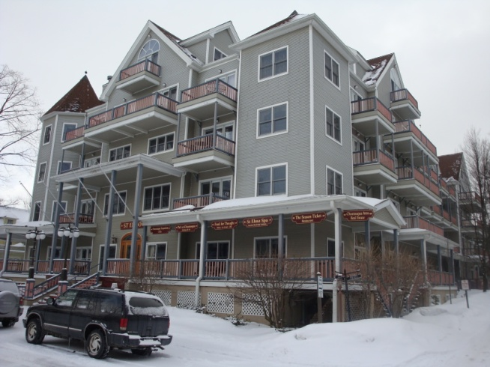
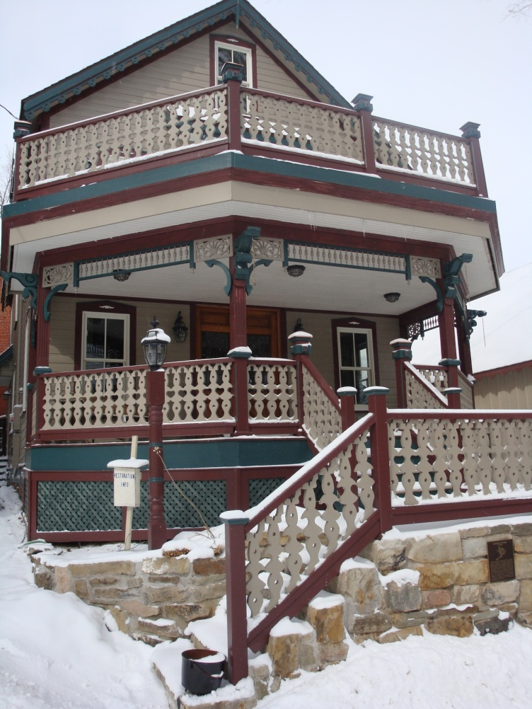
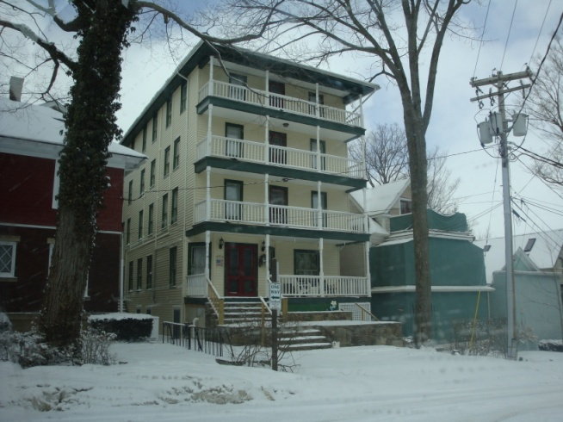
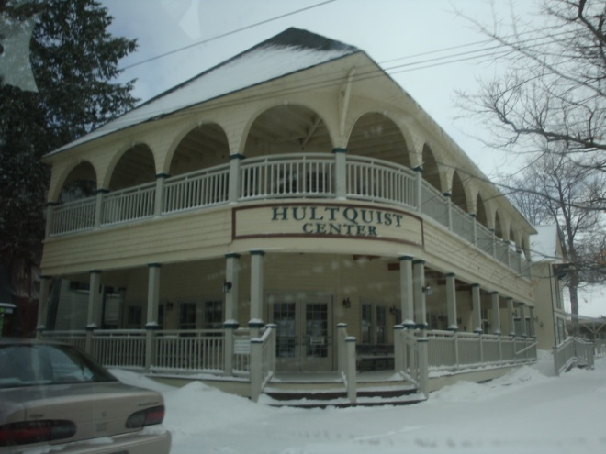
What have we been doing?

Slide 21
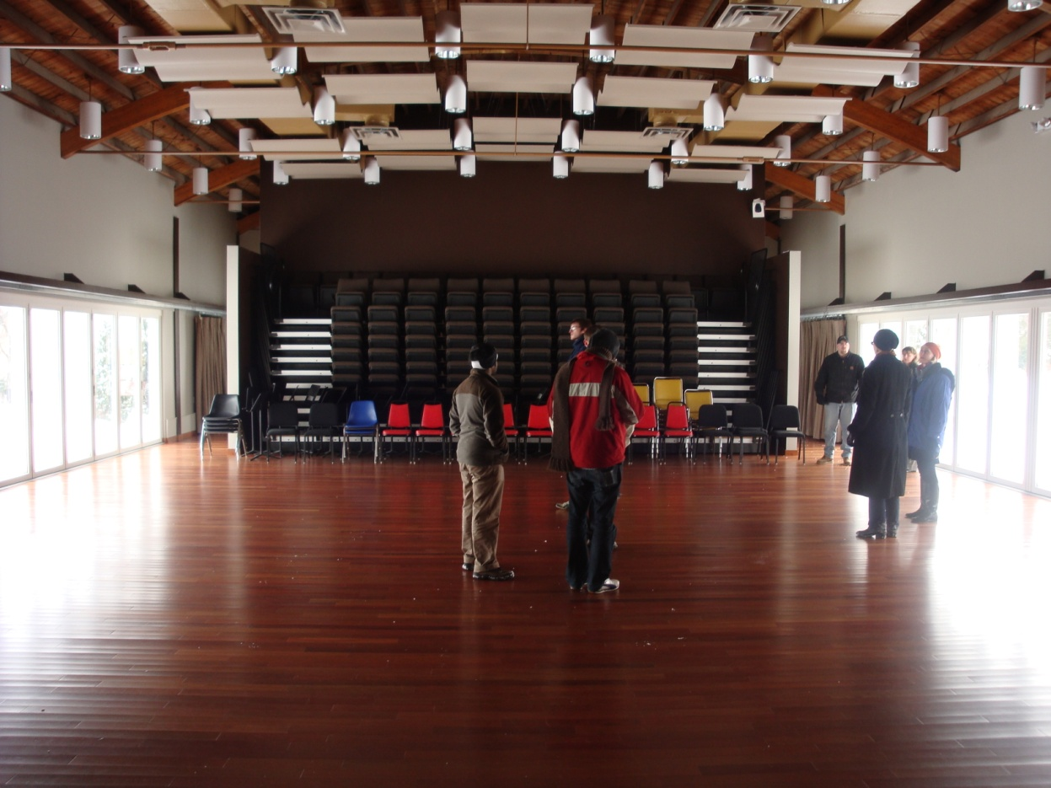
What have we been doing?

Slide 22
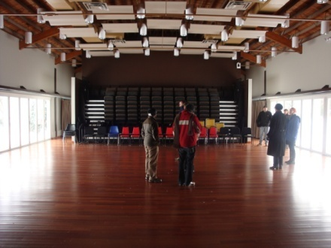
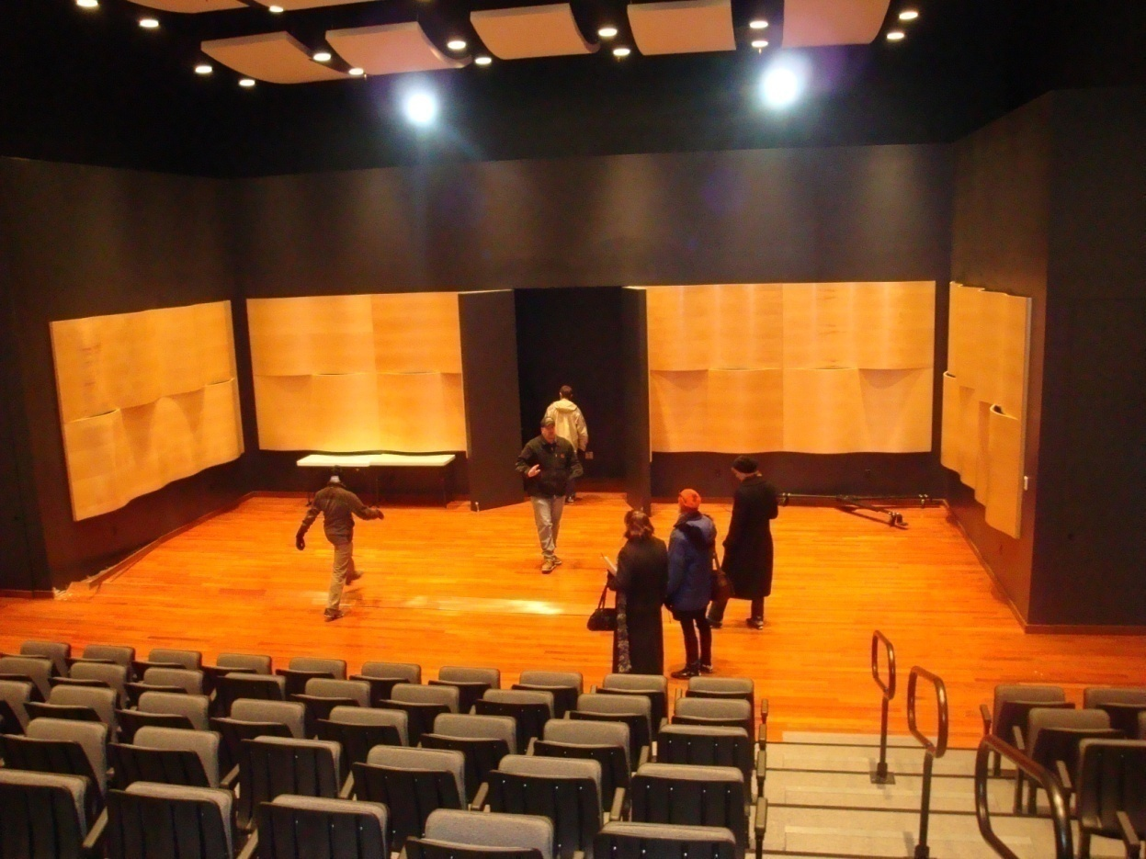
What have we been doing?

Slide 23
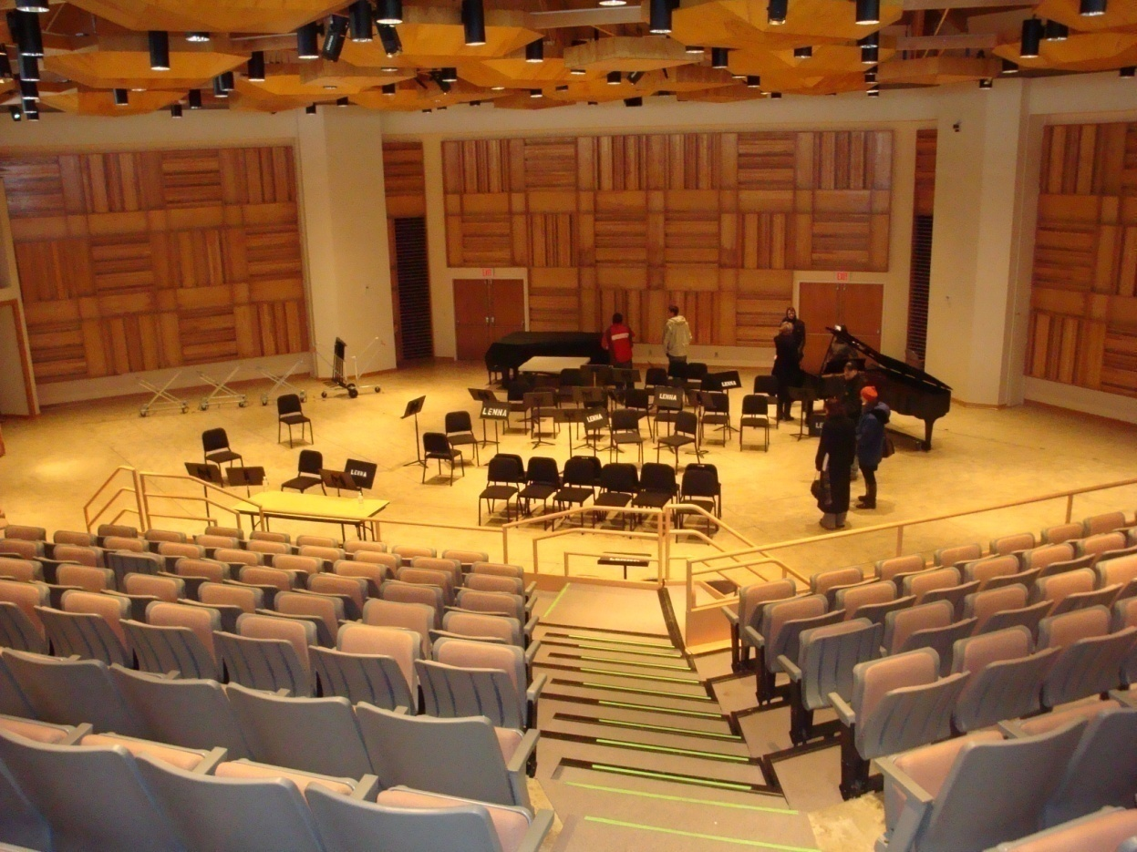
What have we been doing?

Slide 24
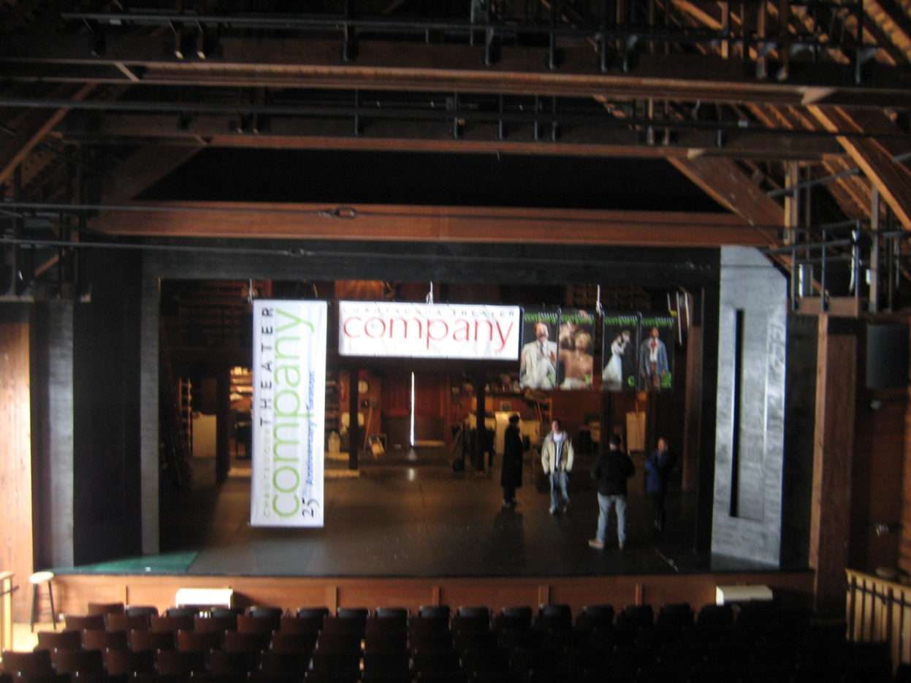
What have we been doing?

Slide 25
Our 2 Prototypes
Rashomon + 360° Dynamic Sound
Hamlet, Rosencrantz and Guildernstern are Dead + Camera Angles

Slide 26
Rashomon

Slide 27
Rashomon
The Story
Bandit
Everyone
Agrees
Wife
Husband

Slide 28
Rashomon
High Concept
Exploiting the emphasis on perspectives in the story “Rashomon” to give an audience meaningful choices to make in a non-traditional theater setting.

Slide 29
Rashomon
Projection Screens
Layout
Projections represent characters in court, while actors represent the reenactment of testimonies
Stage area
Swivel chairs

Slide 30
Rashomon
Beginning Layout
All introductory stories play at the same time, with the audience’s collective attention determining volume levels

Slide 31
Rashomon
Beginning Layout
Audience’s attention will determine which character testifies first

Slide 32
Rashomon
Character’s Testimony
The other characters’ projections react to the story as it is being told

Slide 33
Rashomon
In the end
The performance order potentially varies from one show to the next.
Audience members will be asked to provide judgment.
We will analyze the data and find possible relationships to the play’s order.

Slide 34
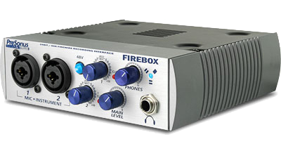
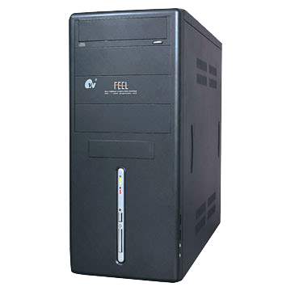
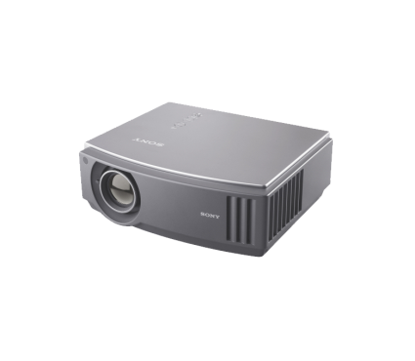
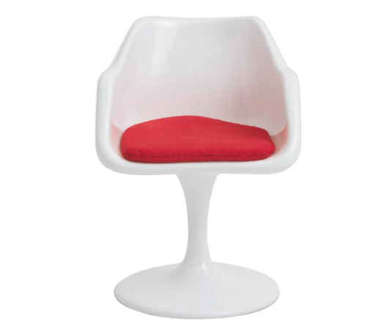
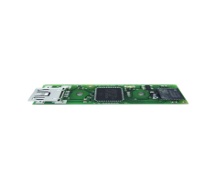
Rashomon

Slide 35
Rashomon
Midi data sent to Max/MSP/Jitter
Midi data sent to external controller
Outputs sound with different volumes to three speakers
Jitter outputs three videos to separate projectors
C++
PC translates sensor data to MIDI
Sensor communicates with PC via USB

Slide 36
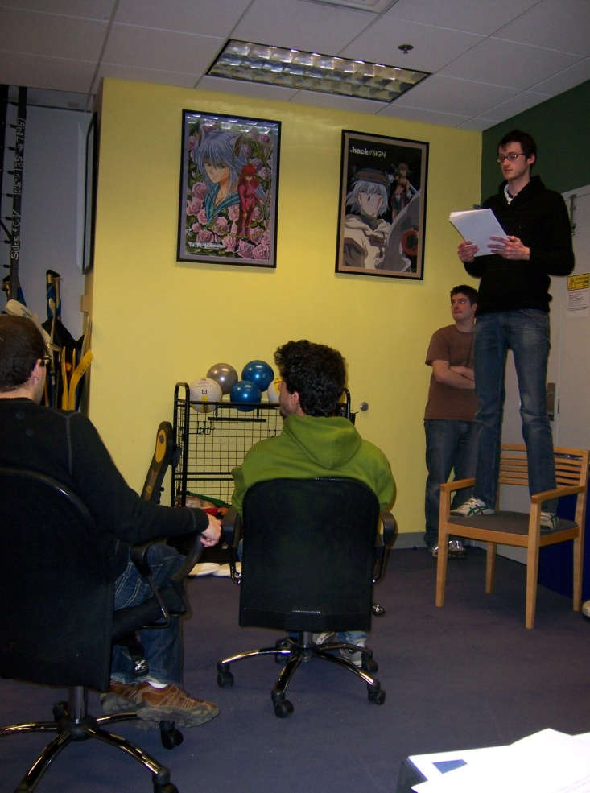
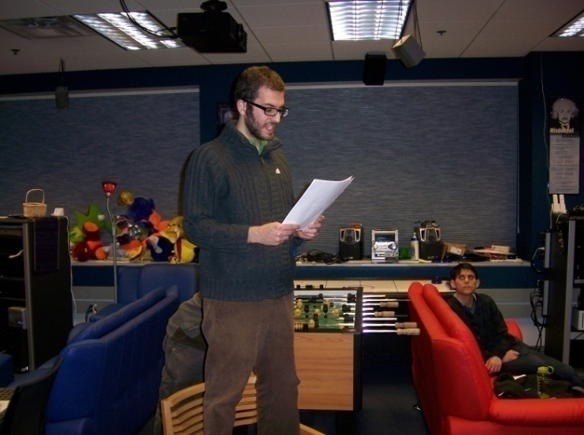
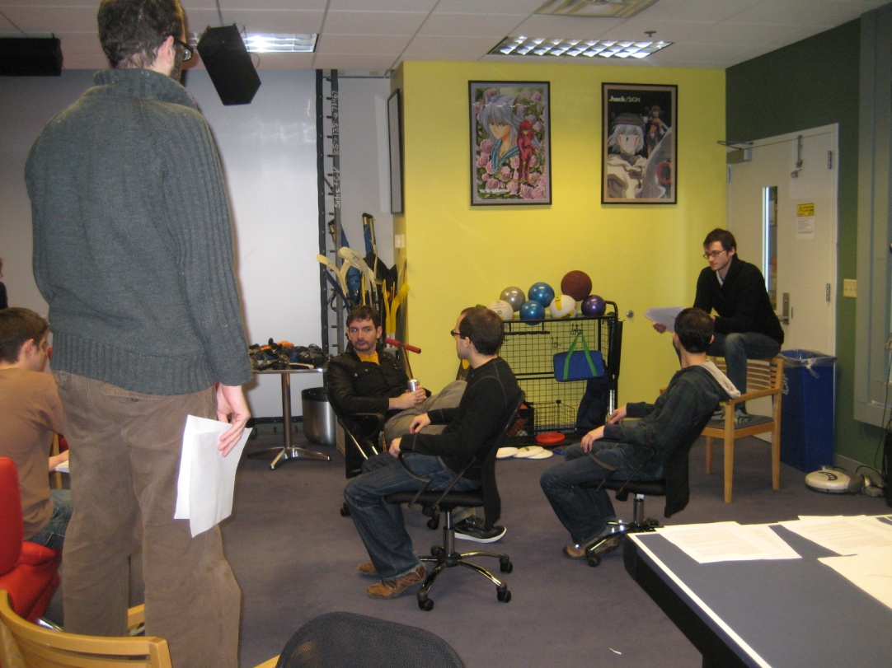
Rashomon
Playtesting
Wizard of Oz Playtesting

Slide 37
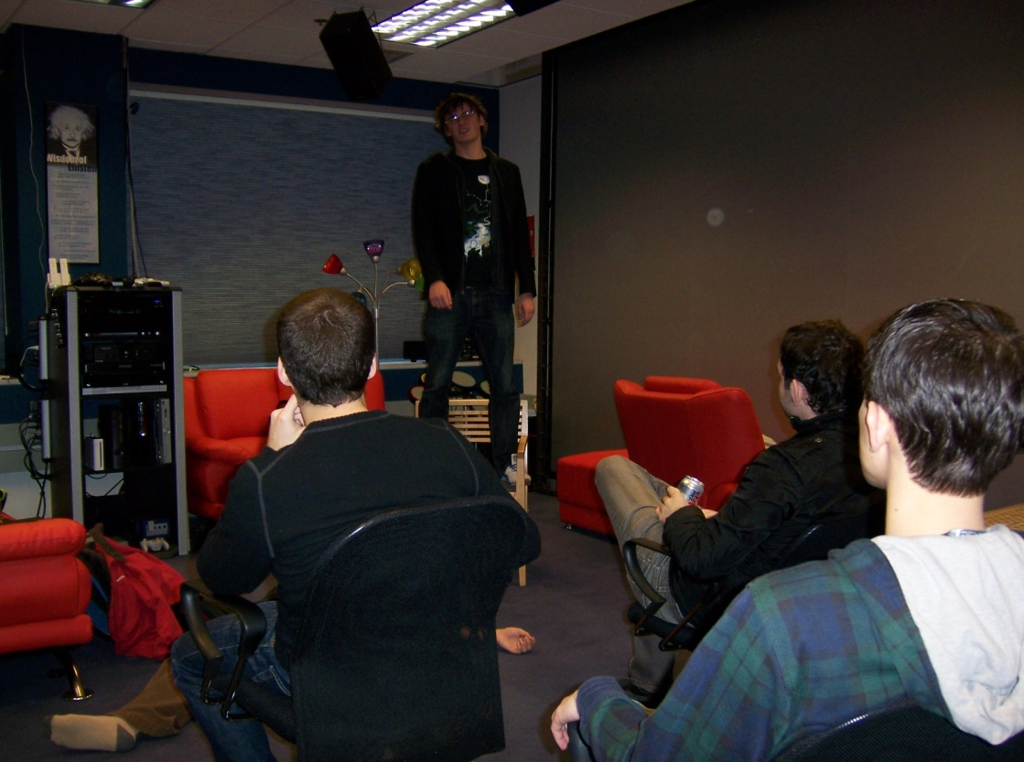
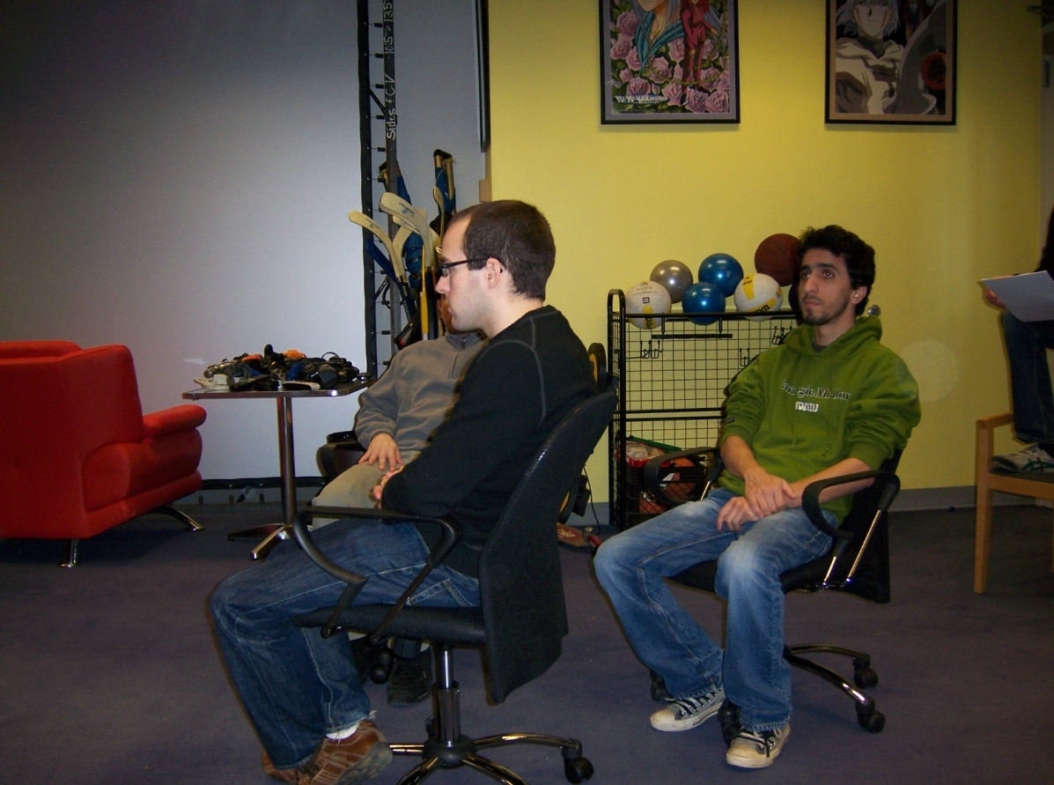
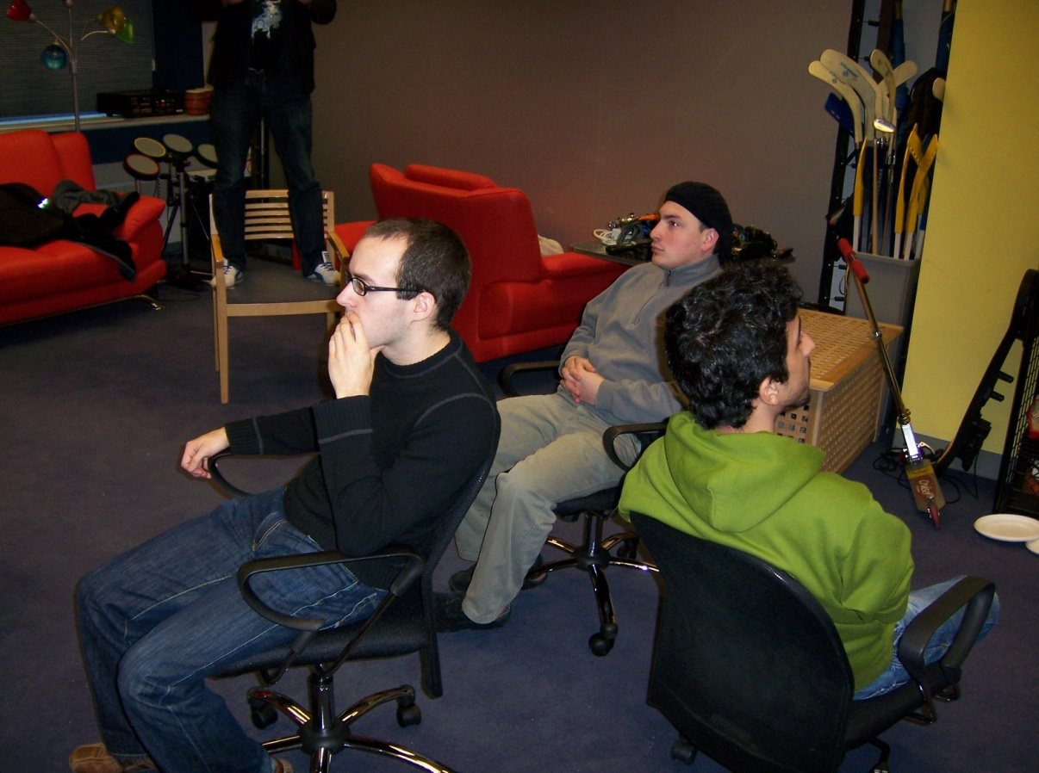
Rashomon
Playtesting

Slide 38
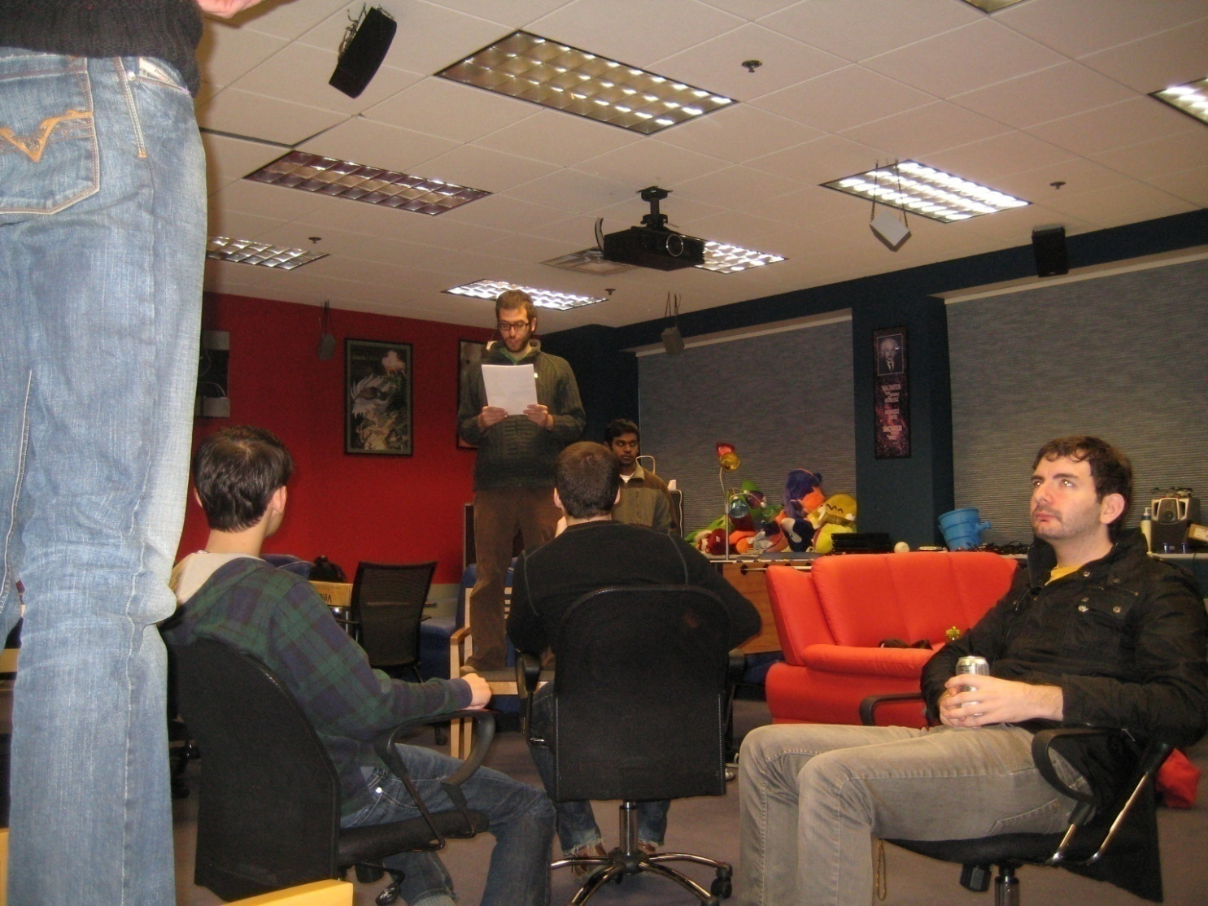
Rashomon
Playtesting
Wizard of Oz Playtesting

Slide 39
Rashomon
Wizard of Oz Playtesting
Feedback
Hard to keep track of everyone speaking at once.
Difficult to imagine without the tech.
Individual experience was affected by other audience members.

Slide 40
Rashomon
Playtesting
Tech Playtesting

Slide 41
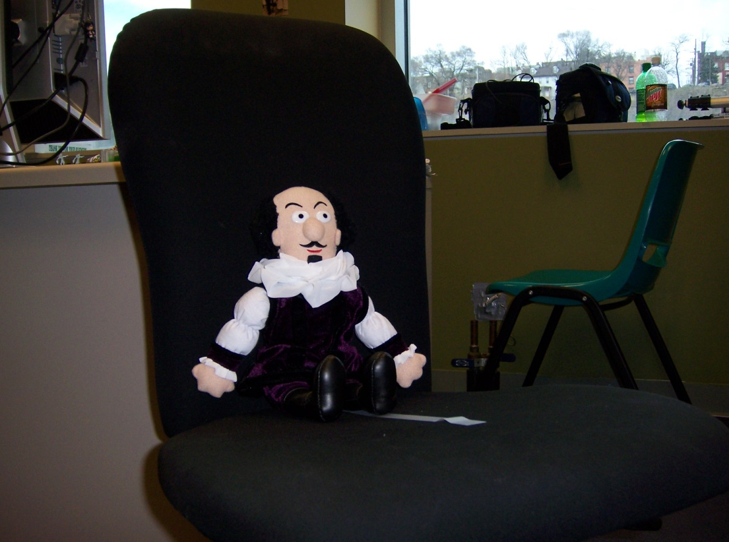
Rashomon
Playtesting
Tech Playtesting

Slide 42
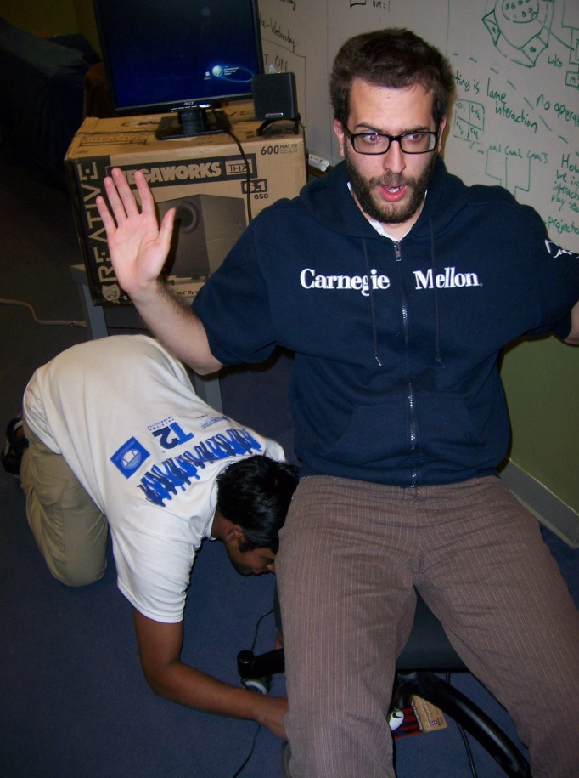
Rashomon
Playtesting

Slide 43
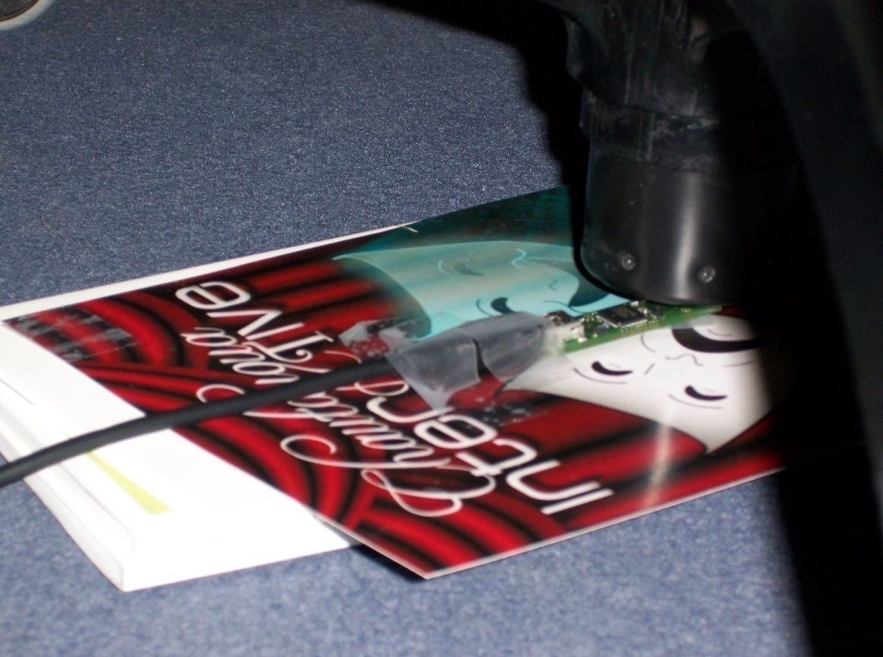
Rashomon
Playtesting

Slide 44
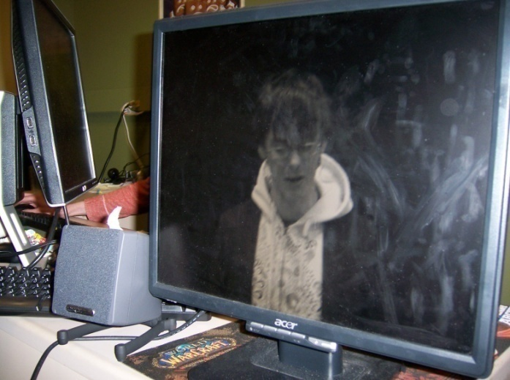
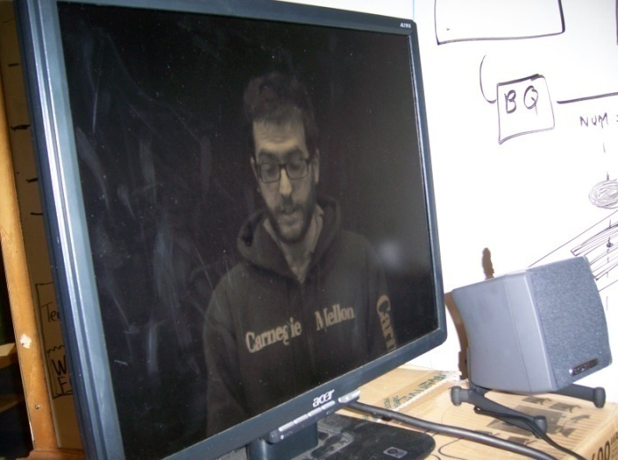
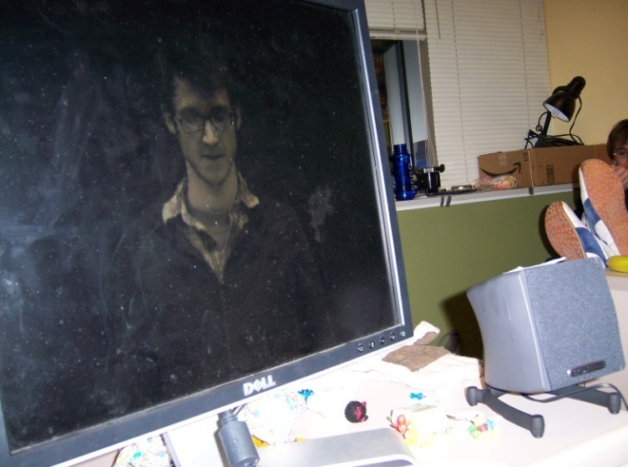
Rashomon
Playtesting

Slide 45
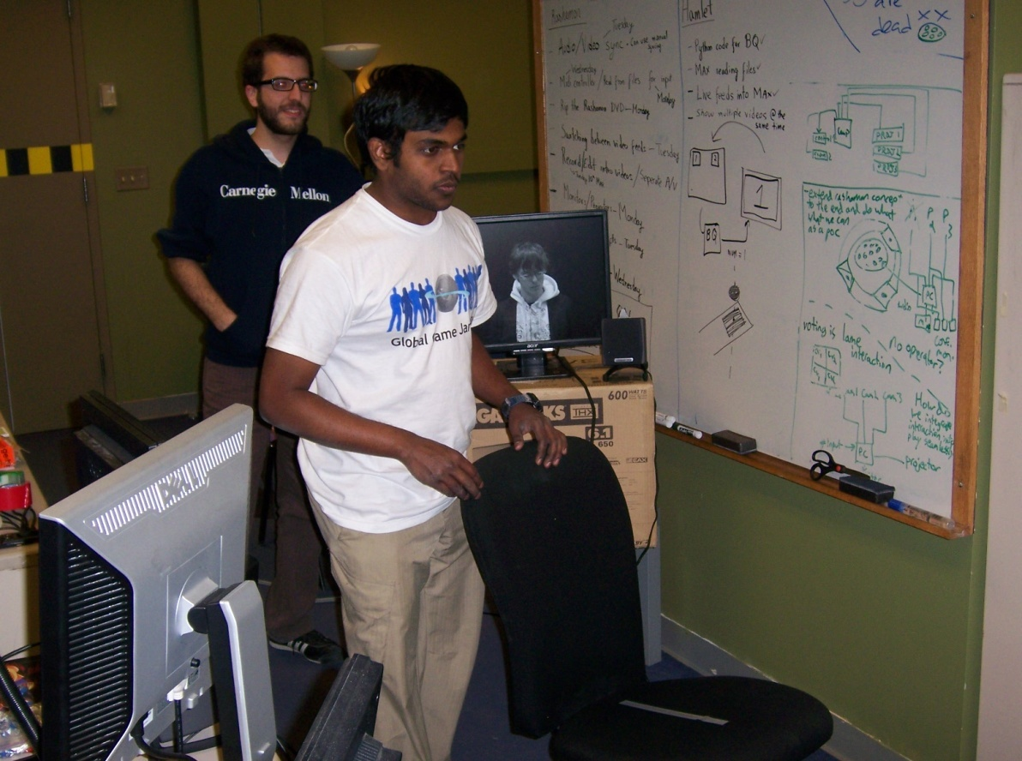
Rashomon
Playtesting

Slide 46
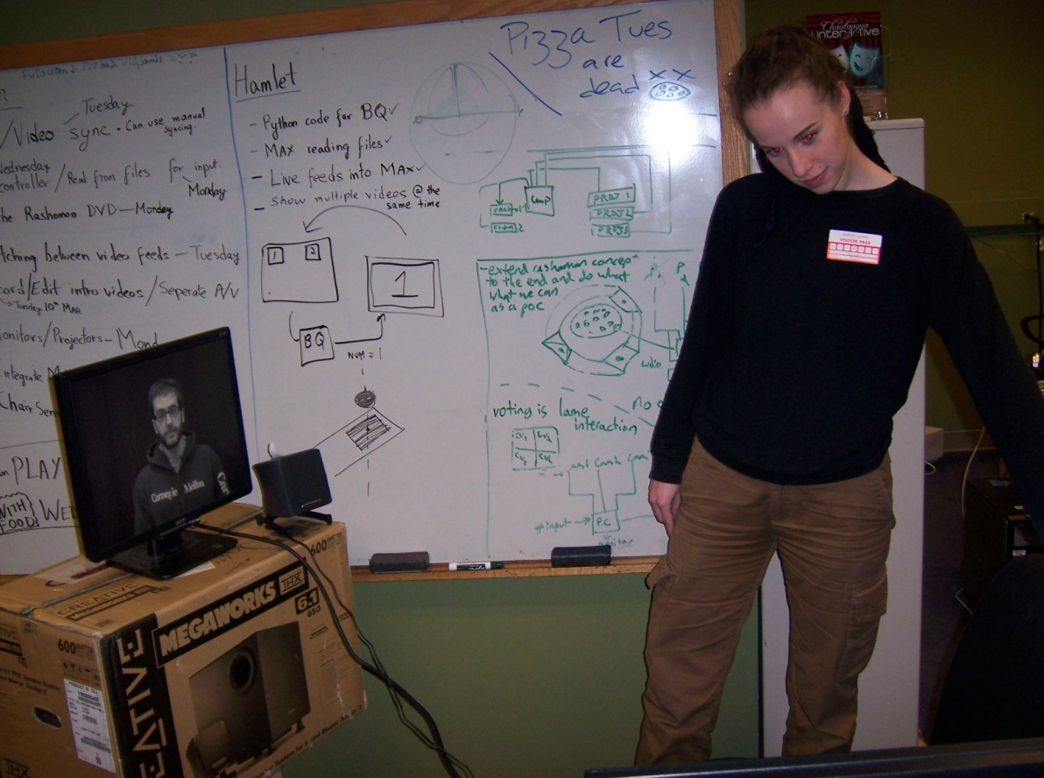
Rashomon
Playtesting

Slide 47
Rashomon
Tech Playtesting
Sensors are very… sensitive.
Additional casing needed to stabilize sensor.
Interaction is working for one chair. No persons allowed on it, though.
Script has to be modified to suit the interaction.

Slide 48
Hamlet

Slide 49
Hamlet
High Concept
Imbuing the audience with the agency to select from various interpretations and supplementary information relating to Hamlet by utilizing various forms of technology.

Slide 50
Hamlet
Story
Scene for Prototype
Act 3, Scene 4: Hamlet confronts Gertrude about her actions. Gertrude confronts Hamlet about his madness. Polonius watches in secret and is killed by Hamlet.
Why this play/scene
Historically significant play that deals with important themes that rely on the character’s and the audience’s perceptions/interpretations of events.

Slide 51
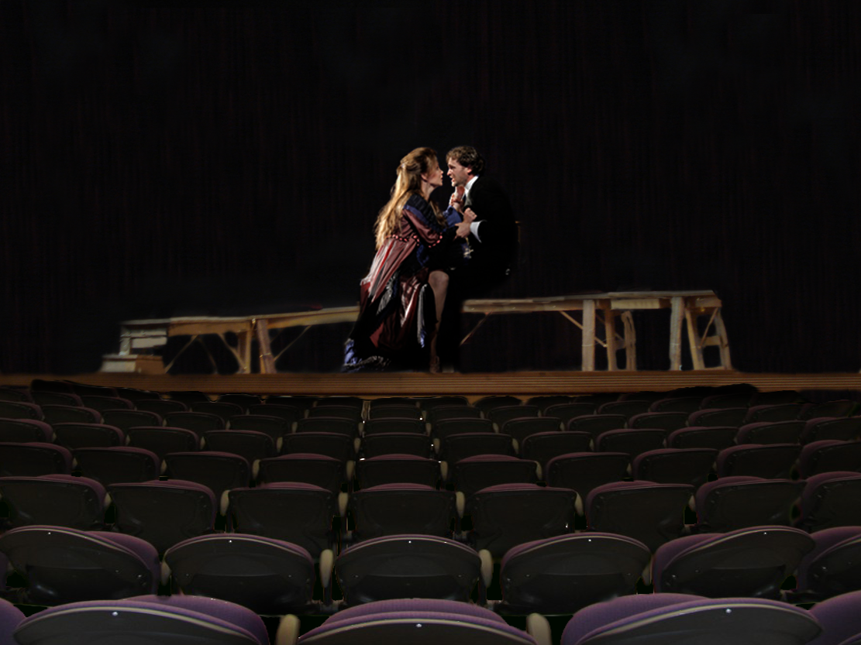
Hamlet
Traditional Stage Layout

Slide 52
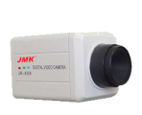
Hamlet

Slide 53
Hamlet

Slide 54
Hamlet

Slide 55
Hamlet

Slide 56
Hamlet

Slide 57
Hamlet

Slide 58
Hamlet

Slide 59
Hamlet

Slide 60
Hamlet

Slide 61
Hamlet
PC
Hardware
Projectors x 2
Capture Card
Mini Dv Cameras x 4
Wearable camera x 1
BQ Remotes

Slide 62
Hamlet
PC
Mix video feeds
and prerecorded
footage in jitter
Hardware
Receive live
camera feeds
Projectors x 2
Capture Card
Send data to Jitter to determine
video projection
Mini Dv Cameras x 4
Wearable camera x 1
Send two processed video streams to projectors
Python
Send voting data to PC
Process
voting
Data
BQ Remotes

Slide 63
Plans for the second half
Chautauqua Interactive 2nd-Half Schedule
Week9 HALF 3/16 - 3/20 |  | Week10 GDC 3/23 - 3/27 |  | Week11 3/30 - 4/3 |  | Week12 4/6 - 4/10 |  | Week13 4/13 - 4/17 |  | Week14 SOFT 4/20 - 4/24 |  | Week15 4/27 - 5/1 |  | Week16 FINAL 5/4 - 5/8
Rashomon Tech (Aaron, Ben, Francisco & Goutham)
Hamlet / R & G are Dead Tech (Aaron, Ben, Francisco & Goutham)
Design Doc, Story Board, & Script Revisions for Both Prototypes (Kyle)
Gathering Resources: Actors & More Proven Hardware (Ben & Kyle)
 | T |  |  |  | E |  | S |  | T |  | I N G
 |  |  |  |  |  |  |  |  |  |  | Polishing (Everyone)

Slide 64
Problems + Risks
Do theatrical audiences really want agency?
Finicky sensor.
Accurate testing group.
September symposium: our project ends in May.

Slide 65
Thanks!
Drew Davidson
Brenda Harger
Allen Hahn
Margaret Johnson
Janice Metz
Caitlin Zunic
Andrew Federspiel
Carlos Hurtado
Oscar Ramírez
Lauren Etta
Bonnie Nelson Schwartz
Marianne Weems
Oscar García
Juan Souki
Debi Pils
Nayoung Kim
Theyab Al Tamimi
Cory Garfin
The Angry Mob
Laura Lantz

Slide 66
Questions?
Visit us at Room #2406
Or
http://www.etc.cmu.edu/projects/chautauqua-festival/
E-mail us at
ChautauquaInteractive2009@gmail.com

